Slide 1

Multiple Test suites in TestNG

Slide 2
Introduction
TestNG enables to run test methods, test classes and test cases in parallel.
In parallel execution, reduce the 'execution time' as tests are started and executed simultaneously in different threads.

Slide 3
Procedure for Execute multiple Test Suites
Create a new project in eclipse.
Create two packages in the projects (name as com.suite1 and com.suite2)
Create a class in each package (name as Flipkart.java and Snapdeal.java).
Create a new file in this project and name it as testing.xml.
Testng.xml contains all configuration (class names, test names and suit names).

Slide 4
Now see the code here:- (package as com.suite1,class as Flipkart.java)
package com.suite1;
import java.util.concurrent.TimeUnit;
import org.openqa.selenium.Alert;
import org.openqa.selenium.By;
import org.openqa.selenium.WebDriver;
import org.openqa.selenium.WebElement;
import org.openqa.selenium.firefox.FirefoxDriver;
import org.openqa.selenium.interactions.Actions;
import org.testng.annotations.AfterClass;
import org.testng.annotations.BeforeClass;
import org.testng.annotations.Test;
public class Flipkart{
WebDriver driver = new FirefoxDriver();
String username = ""; // Change to your username and passwrod
String password = "“;
// This method is to navigate flipkart URL
@BeforeClass
public void init() {
driver.manage().window().maximize();
driver.manage().timeouts().implicitlyWait(60, TimeUnit.SECONDS);
driver.navigate().to("https://www.flipkart.com");}

Slide 5
// To log in flipkart
@Test
public void login() {
driver.findElement(By.partialLinkText("Login")).click();
driver.findElement(By.cssSelector(".fk-input.login-form-input.user-email")).sendKeys(username);
driver.findElement(By.cssSelector(".fk-input.login-form-input.user-pwd")).sendKeys(password);
driver.findElement(By.cssSelector(".submit-btn.login-btn.btn")).click();
}
// Search For product
@Test
public void searchAndSelectProduct() {
driver.findElement(By.id("fk-top-search-box")).sendKeys("moto g3");
driver.findElement(By.cssSelector("search-bar-submit.fk-font-13.fk-font-bold")).click();
// select the first item in the search results
String css = ".gd-row.browse-grid-row:nth-of-type(1) > div:nth-child(1)>div>div:nth-child(2)>div>a";
driver.findElement(By.cssSelector(css)).click();
}
@Test
public void buyAndRemoveFromCart() {
driver.findElement(By.cssSelector(".btn-express-checkout.btn-big.current")).click();
driver.findElement(By.cssSelector(".remove.fk-inline-block")).click();
Alert a = driver.switchTo().alert();
a.accept();
}

Slide 6
@Test
public void logout() {
Actions s = new Actions(driver);
WebElement user = driver.findElement(By.partialLinkText(username));
s.moveToElement(user).build().perform();
driver.findElement(By.linkText("Logout")).click();
}
@AfterClass
public void quit() {
driver.close();
}
}

Slide 7
Now see the code here:- (package as com.suite2,class as SnapDeal.java)
package com.suite2;
import java.util.concurrent.TimeUnit;
import org.openqa.selenium.Alert;
import org.openqa.selenium.By;
import org.openqa.selenium.WebDriver;
import org.openqa.selenium.WebElement;
import org.openqa.selenium.firefox.FirefoxDriver;
import org.openqa.selenium.interactions.Actions;
import org.testng.annotations.AfterClass;
import org.testng.annotations.BeforeClass;
import org.testng.annotations.Test;
public class SnapDeal{
WebDriver driver = new FirefoxDriver();
String username = ""; // Change to your username and passwrod
String password = "“;
// This method is to navigate snapdeal URL
@BeforeClass
public void init() {
driver.manage().window().maximize();
driver.manage().timeouts().implicitlyWait(60, TimeUnit.SECONDS);
driver.navigate().to("https://www. snapdeal.com");}

Slide 8
// To log in snapdeal
@Test
public void login() {
driver.findElement(By.xpath("//button[text()='Login']")).click();
driver.switchTo().frame("loginIframe");
driver.findElement(By.cssSelector("div[onClick='getLoginForm()']")) .click();
driver.findElement(By.id("j_username")).sendKeys(username);
driver.findElement(By.id("j_password_login")).sendKeys(password);
driver.findElement(By.id("signin_submit")).click();
driver.switchTo().defaultContent();
}
// Search For product
@Test
public void searchAndSelectProduct() {
driver.findElement(By.cssSelector(".col-xs-20.searchformInput.keyword")).sendKeys("iphone 6s");
driver.findElement(By.cssSelector(".sd-icon.sd-icon-search")).click();
// select the first item in the search results
String css = ".product_grid_row:nth-of-type(1)>div:nth-child(1)";
driver.findElement(By.cssSelector(css)).click();
}

Slide 9
@Test
public void buyAndRemoveFromCart() {
driver.findElement(By.xpath("//li[contains(text(),'Silver')]")).click();
driver.findElement(By.id("pincode-check")).sendKeys(pinCode);
driver.findElement(By.id("buy-button-id")).click();
driver.findElement(By.cssSelector("i[title='Delete Item']")).click();
Alert a = driver.switchTo().alert();
a.accept();
}
@Test
public void logout() {
driver.findElement(By.linkText("START SHOPPING NOW")).click();
Actions s = new Actions(driver);
WebElement user = driver.findElement(By.cssSelector(".sd-icon.sd-icon-user"));
s.moveToElement(user).build().perform();
driver.findElement(By.linkText("Logout")).click();
}
@AfterClass
public void quit() {
driver.close();
}
}

Slide 10
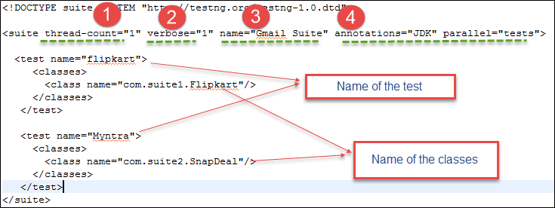
Creating TestNg.xml file code mention below:-
1)thread-count: This is used for parallel execution, based on the number script. It will execute in parallel or sequential order.
2) verbose: It is used to log the execution details in the console. The value should be 1-10.
3) name: Name of the suite.
4) Parallel: To run scripts parallel, value can be tests/classes/methods/suites. Default value is none.

Slide 11
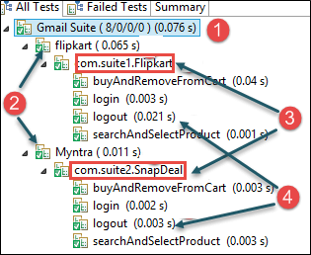

Output:-
name of the suite given in testng.xml
name of the test given in testng.xml
name of the class given in testng.xml
method names annotated with @Test in .java file

Slide 12
Covered Till Now
TestNG enables to run test methods, test classes and test cases in parallel.
In parallel execution, reduce the 'execution time' as tests are started and executed simultaneously in different threads.
Procedure of executing multiple test suites.
Creating TestNg.xml file .

Slide 13
Thanks

